Slide 1


Group 1: Fast food outlet
Task: To create an audio-visual advertisement for a fast food restaurant using the characters and product provided.
Write the dialogue for your advertisement.
Record your voices.
Sync the talking character with your speech.
Add any additional imagery or decoration if needed.

Slide 2
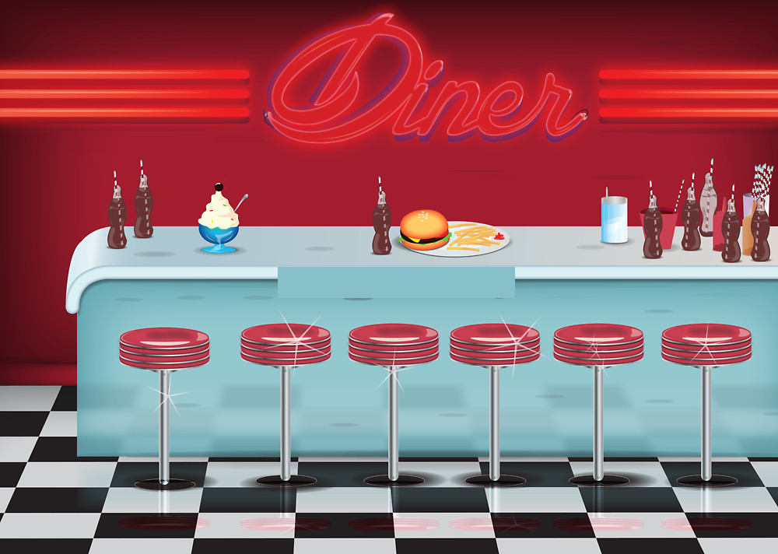




ROUTES
ROUTES

Slide 3
ROUTES
ROUTES

Slide 4
ROUTES
ROUTES

Slide 5
By
(Type all of your team’s names here)

Slide 6






