Slide 1


Group 3: Crisps
Task: To create an audio-visual advertisement for crisps using the characters and product provided.
Write the dialogue for your advertisement.
Record your voices.
Sync the talking character with your speech.
Add any additional imagery or decoration if needed.

Slide 2
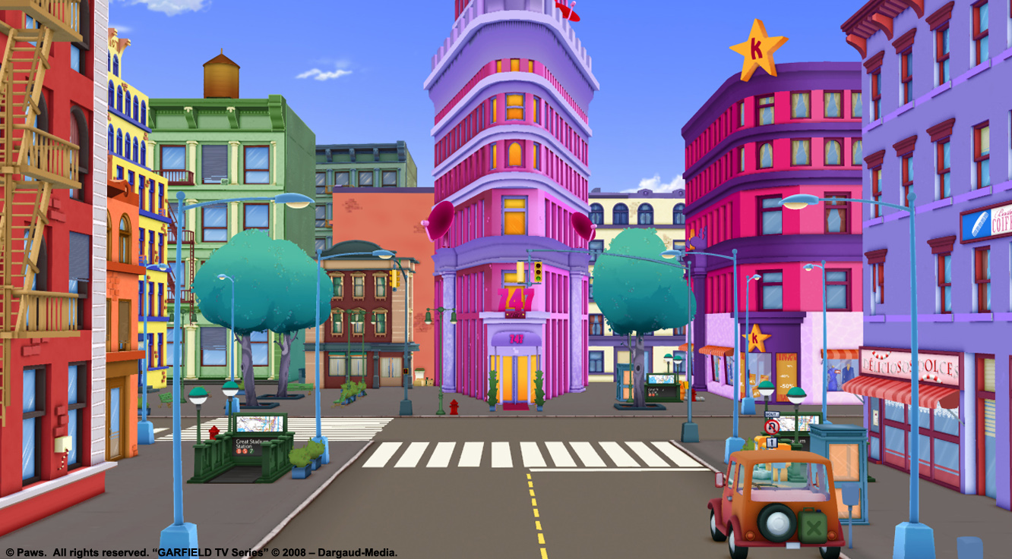



ROUTES

Slide 3
ROUTES

Slide 4
ROUTES

Slide 5
By
(Type all of your team’s names here)

Slide 6
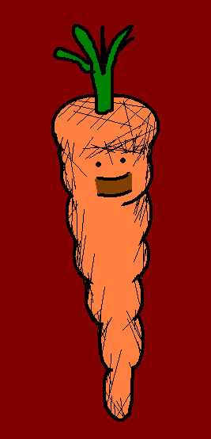
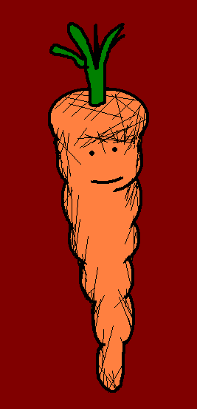


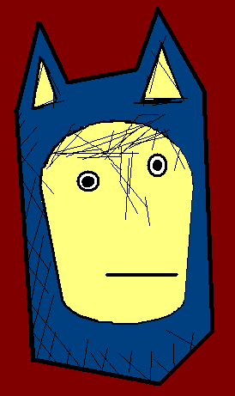
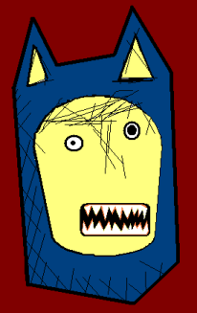





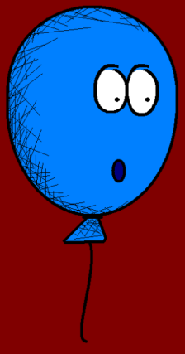



Slide 7











