Slide 1


Group 4
Your school is hosting some curious and whacky exchange students. They have all decided to get a pet together, but can’t decide what kind.
In groups, write a conversation between the characters in which they ask about their favourite animals and choose a pet.
Remember: There is no limit on the type or number of pets. Use your imagination!

Slide 2
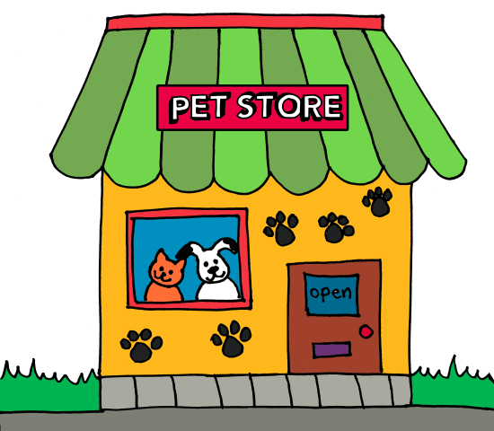





Slide 7
Here are some other whacky talking characters you can use.

Slide 8













Slide 9









